Slide 1
Great Britain

Slide 2


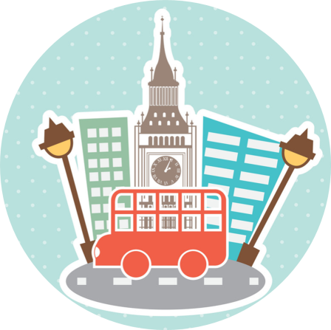
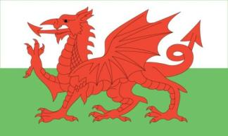
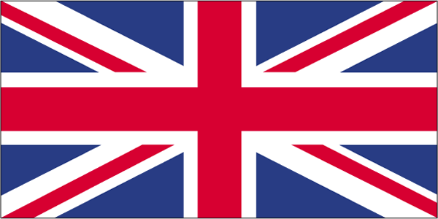
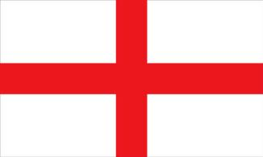
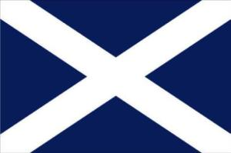
What’s the flag of
England?
2
1
3
4

Slide 3
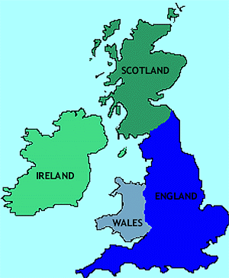
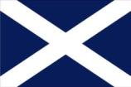
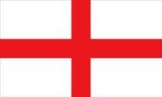
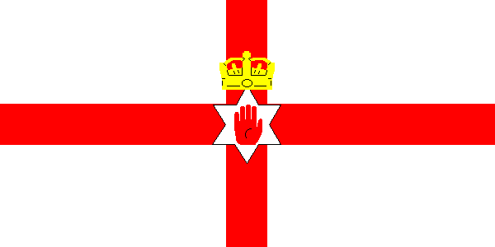

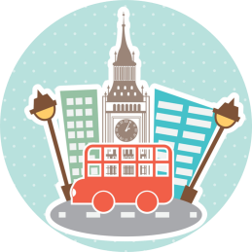
2. Which is the biggest country?
1. Scotland
2. England
3. Northern
Ireland
4. Wales

Slide 4
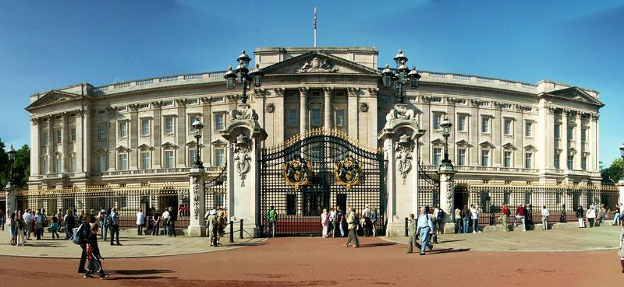
3. What can you see
on the photo?
1. Buckingham Palace
2. Tower of London
3. London Eye

Slide 5
Which is the longest river in Britain?

Slide 6
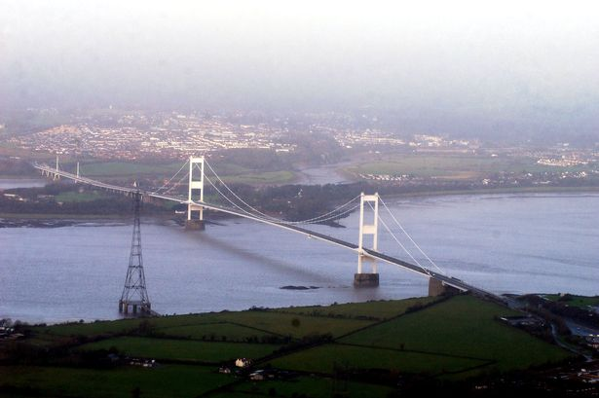
the Severn.

Slide 7
Who is the official head of the UK?

Slide 8
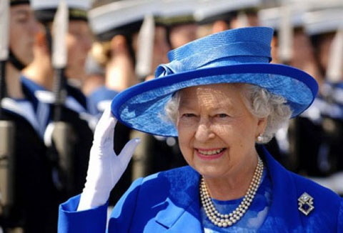
The Queen

Slide 9
What place is the official home of the Queen?

Slide 10
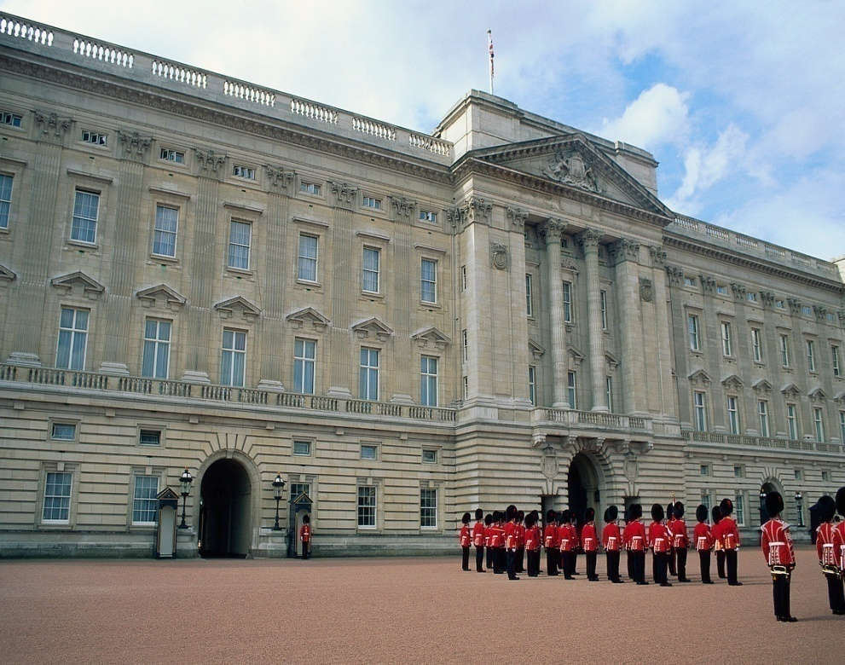
Buckingham Palace

Slide 11
The political centre of London is…

Slide 12
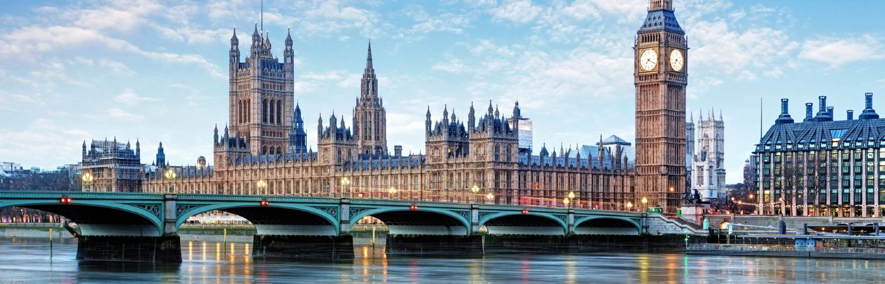
Westminster

Slide 13
What street do many British government offices stand in?

Slide 14
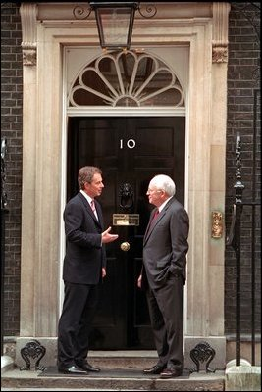
Whitehall

Slide 15
The British flag is often called…

Slide 16
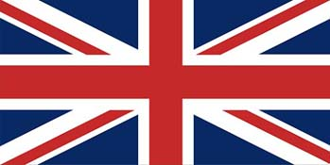
The Union Jack

Slide 17
Which London park is famous for its Speakers’ Corner where you can make any speech you like?

Slide 18
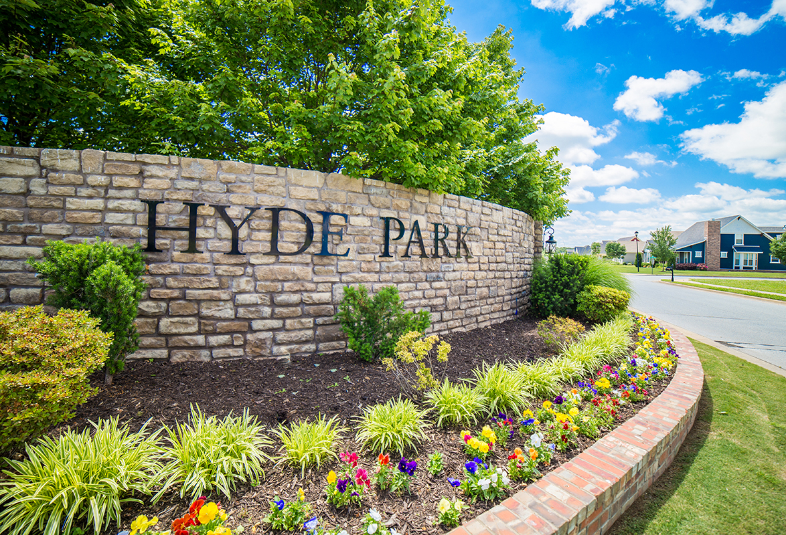
Hyde Park

Slide 19
What sport has its famous club in Manchester?

Slide 20
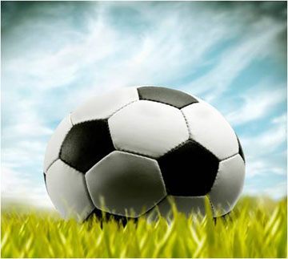
Football

Slide 21
Read and match
Big
Trafalgar
Bloody
White
Buckingham
Westminster
The Houses of
The Tower of
Palace
Tower
London
Bridge
Ben
Square
Tower
Parliament

Slide 22
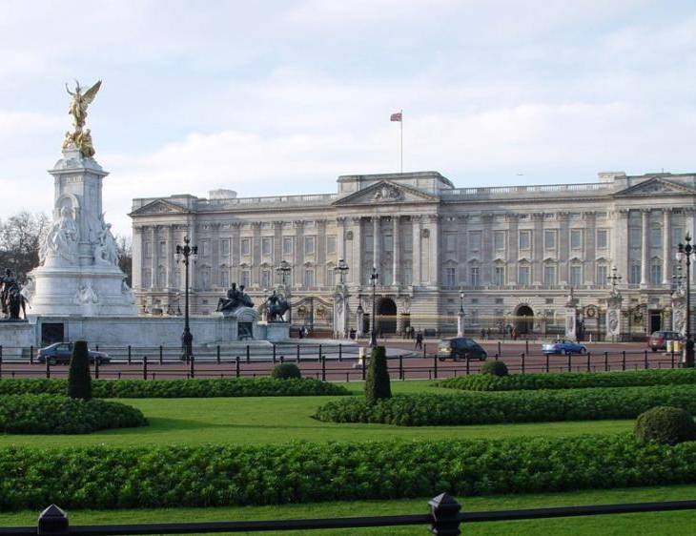


The Houses of Parliament
Buckingham Palace
Westminster Abbey

Slide 23
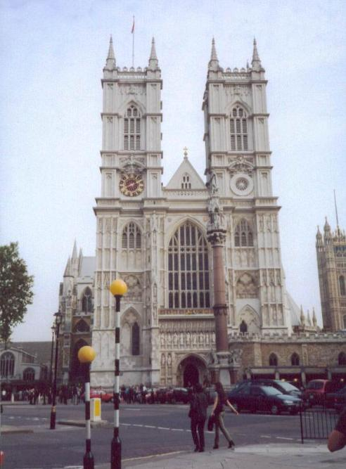
Tower Bridge
London Eye
Westminster Abbey

Slide 24
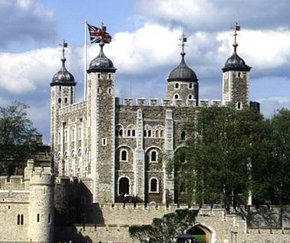
The Tower of London
St. Paul’s
Trafalgar Square

Slide 25
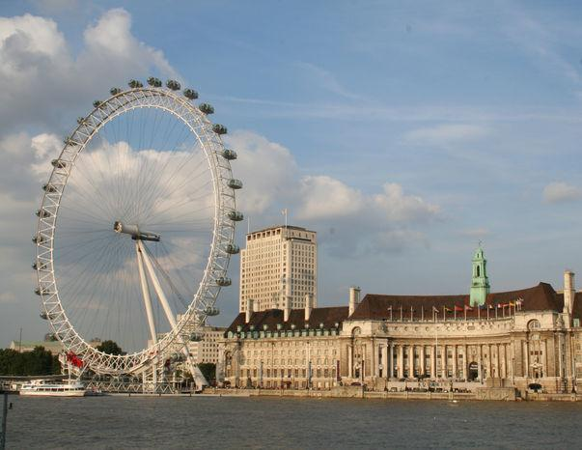
London Zoo
London Eye
London Bridge

Slide 26
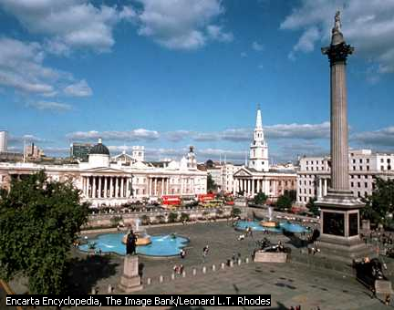
Tate Gallery
London Bridge
Trafalgar Square

Slide 27
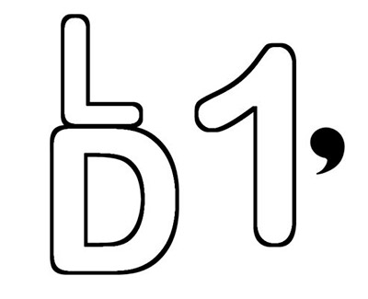
LONDON

Slide 28
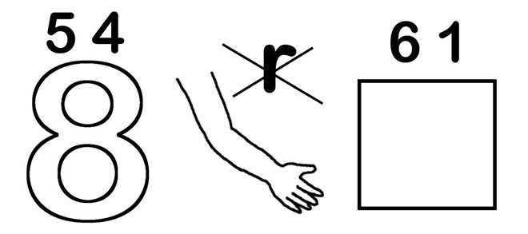
THAMES

Slide 29
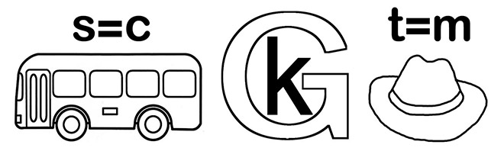
Buckingham

Slide 30
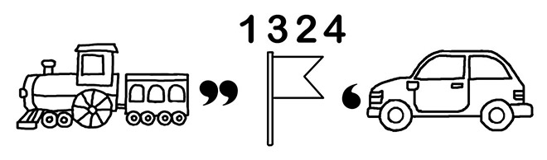
Trafalgar

Slide 31
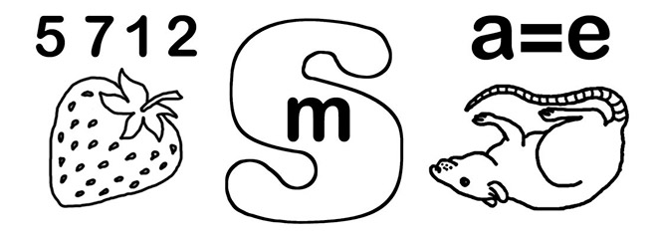
Westminster

Slide 32
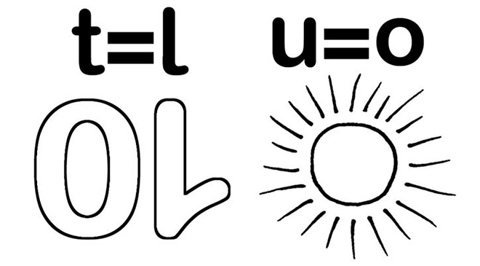
Nelson

Slide 33
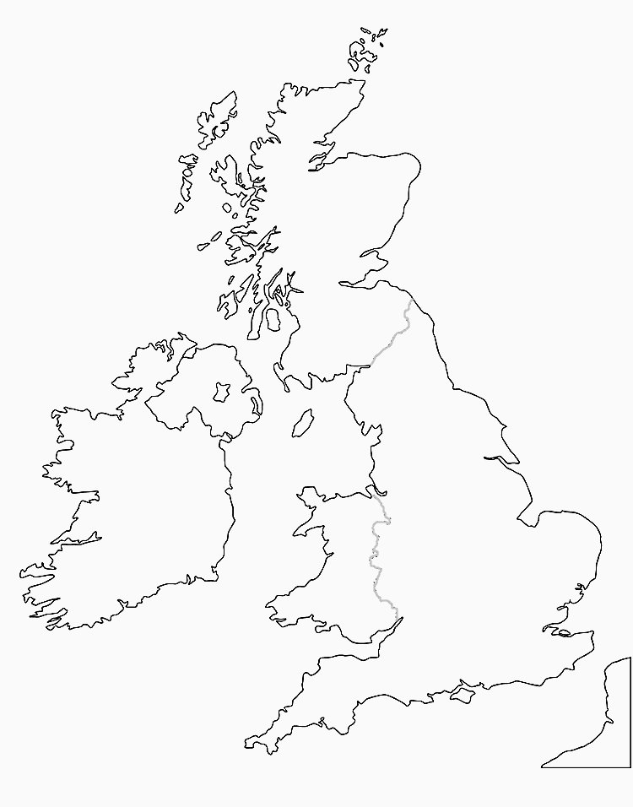

Slide 34
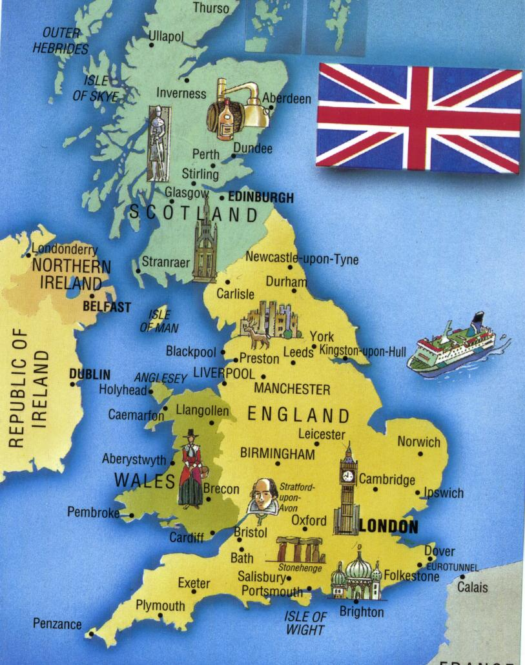

Slide 35
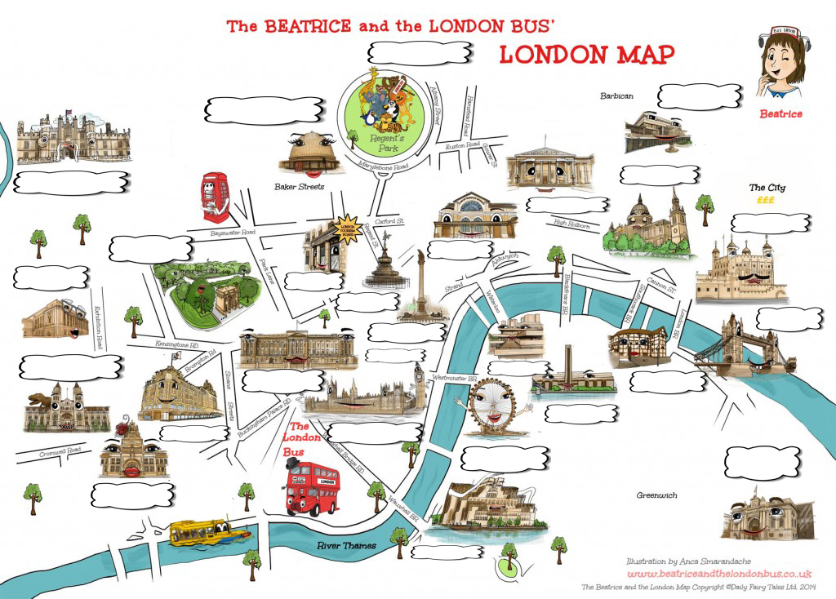

Slide 36
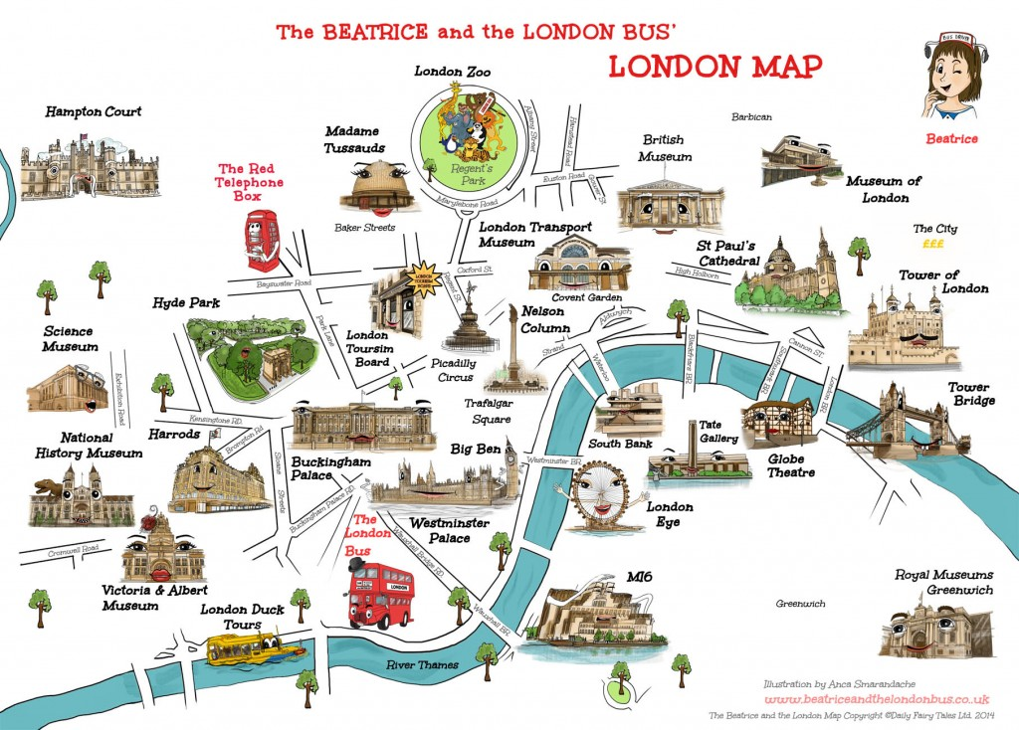

Slide 37
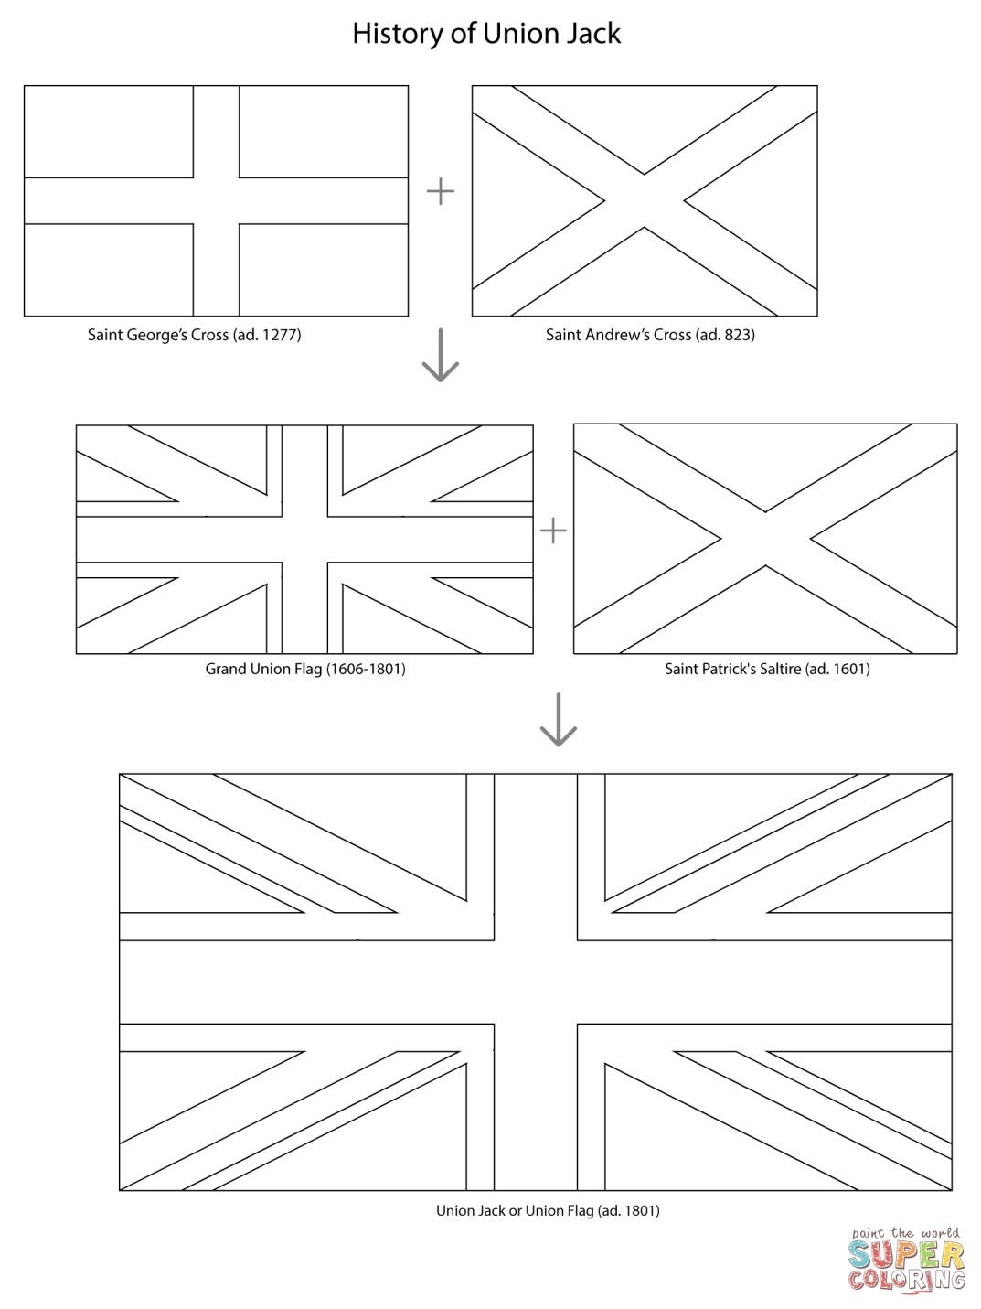

Slide 38
