Slide 1
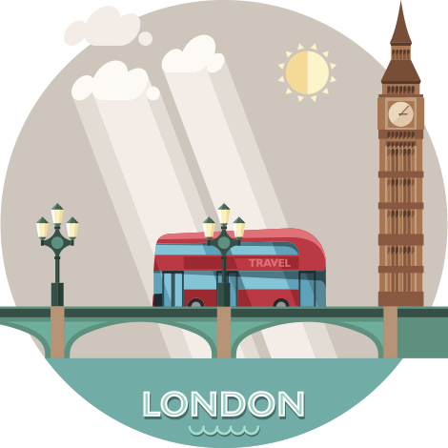
I want to know everything

Slide 2
Round I
Do you know Great Britain?

Slide 3
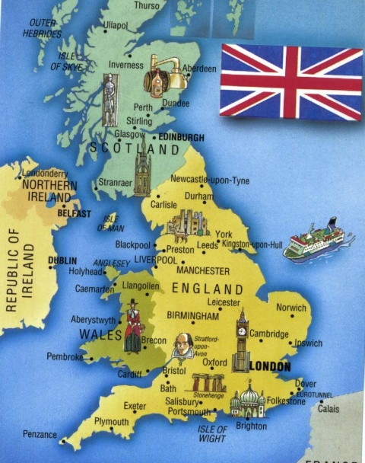
№1. How many parts are there in Great Britain?
START TIMER
TIME’S UP!

Slide 4
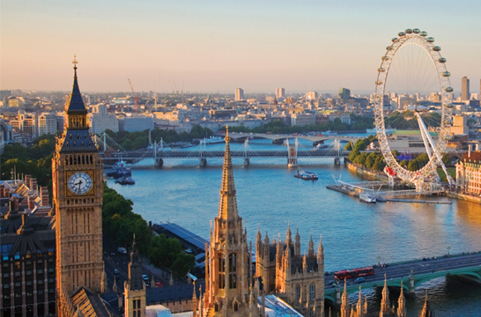
№2. What is the capital of Great Britain?
START TIMER
TIME’S UP!

Slide 5
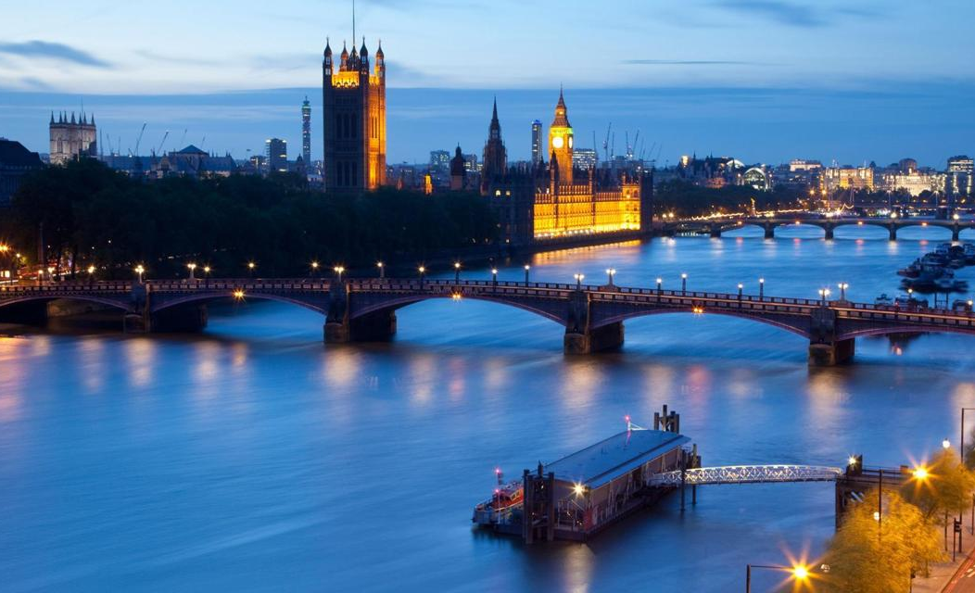
№3. What river is the British capital situated on?
START TIMER
TIME’S UP!

Slide 6
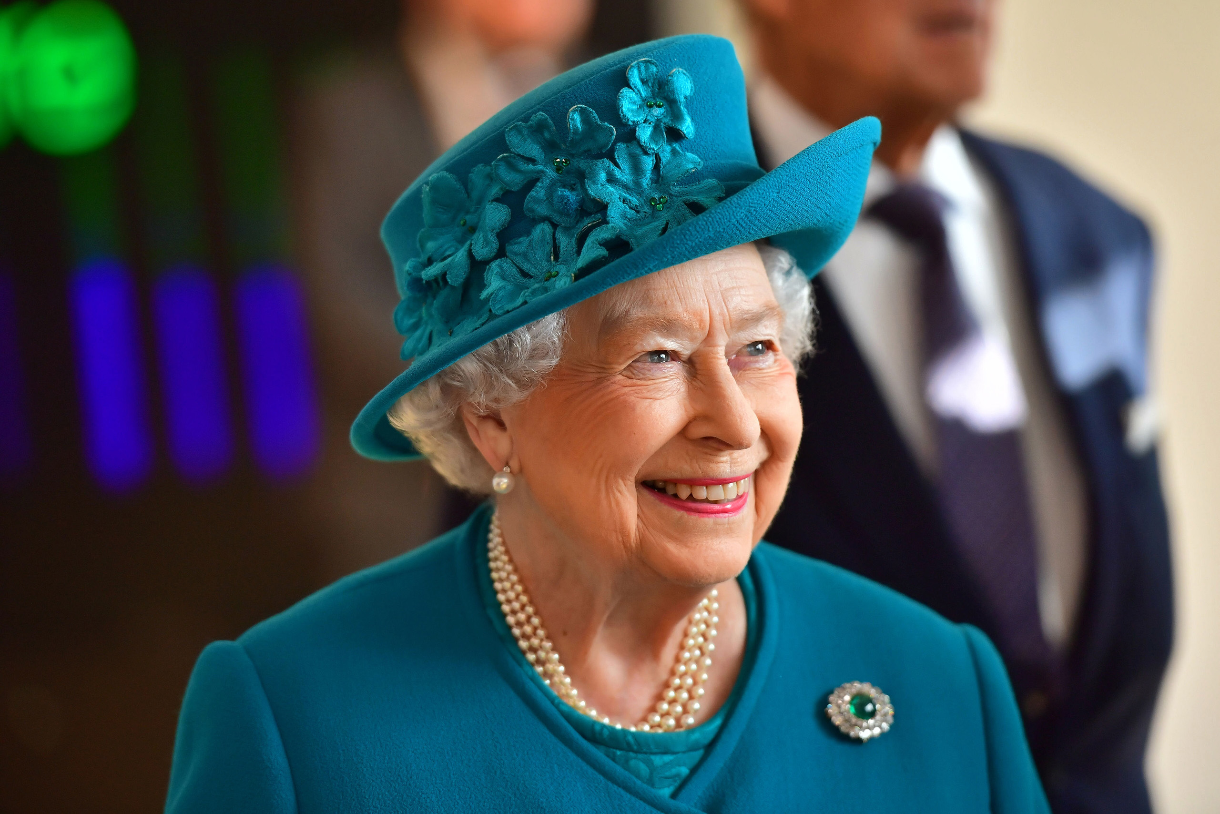
№4. Who is the head of the country?
START TIMER
TIME’S UP!

Slide 7
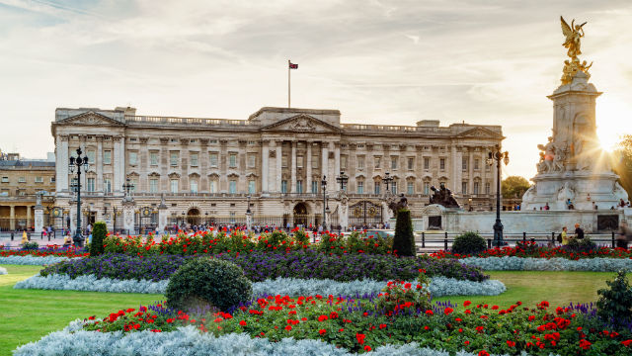
№5. What is the home of the Queen?
START TIMER
TIME’S UP!

Slide 8
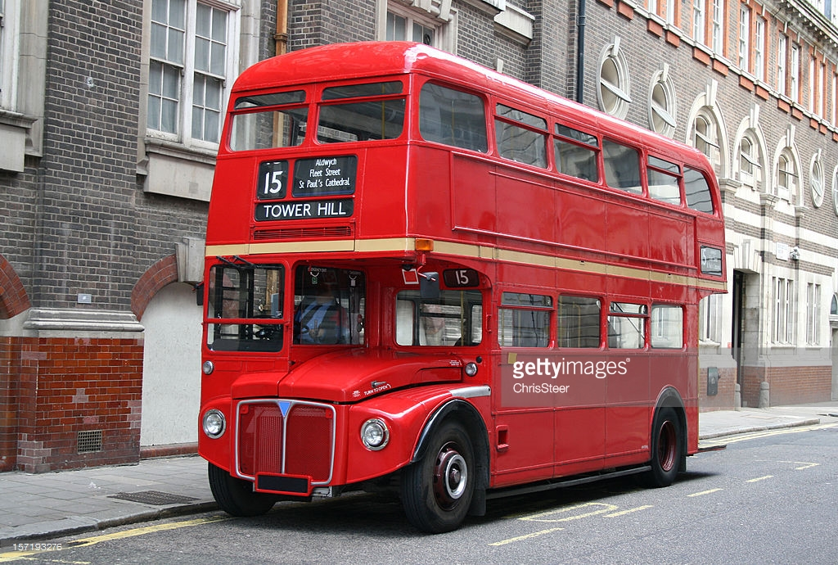
№6. What is the double-decker?
START TIMER
TIME’S UP!

Slide 9
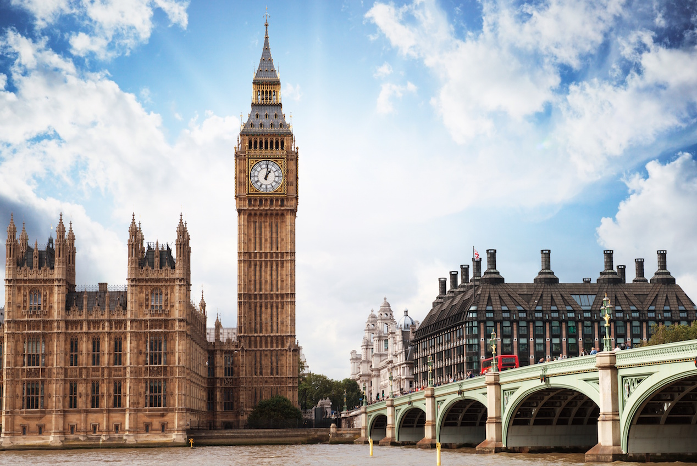
№7. What is Big Ben ?
START TIMER
TIME’S UP!

Slide 10
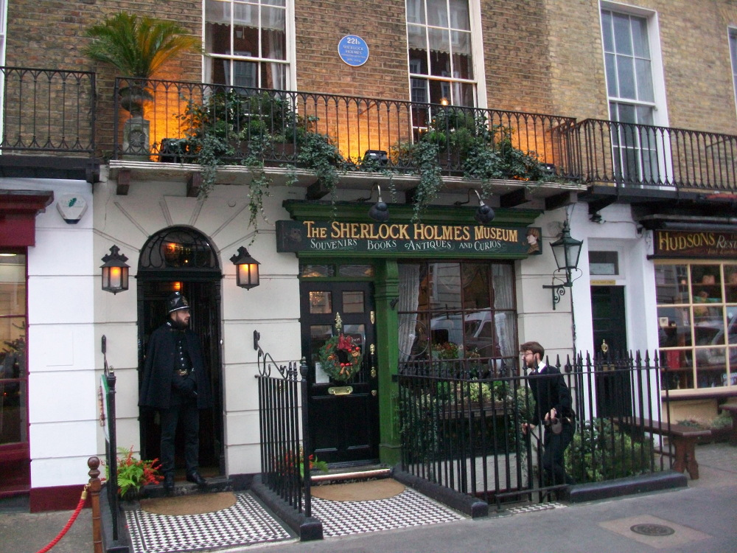
№8. Where did the detective Sherlock Holmes live?
START TIMER
TIME’S UP!

Slide 11
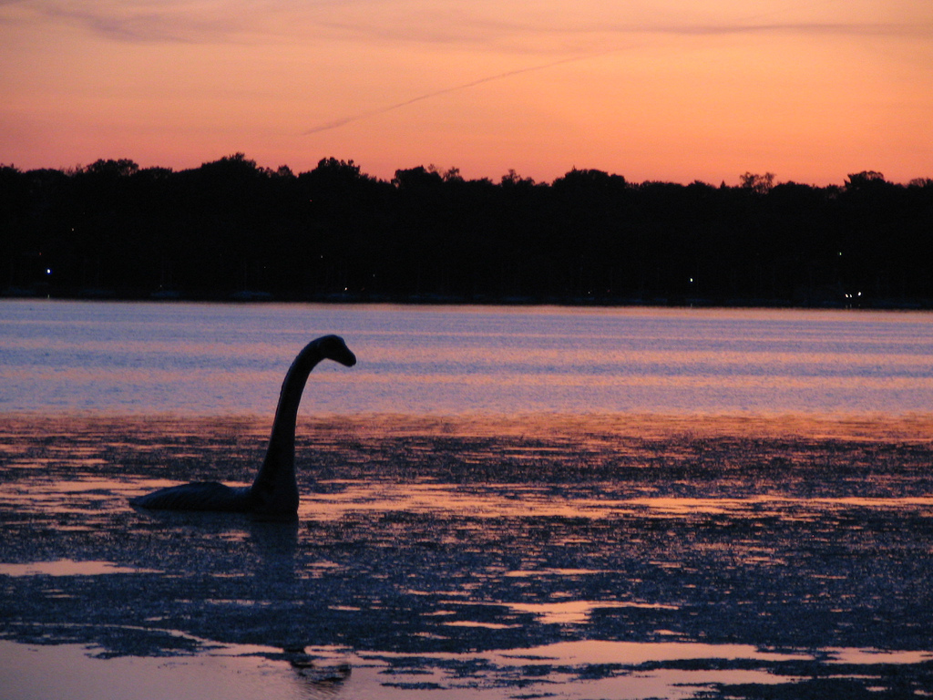
№9. What is the most famous lake in Scotland ?
START TIMER
TIME’S UP!

Slide 12
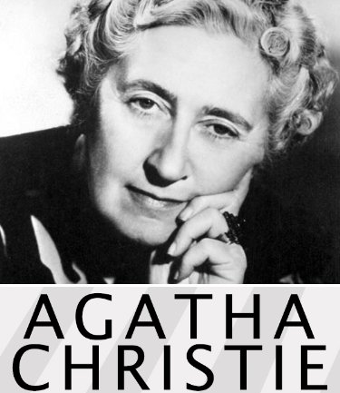
№10. Who is the most famous woman-writer of detective stories?
START TIMER
TIME’S UP!

Slide 13
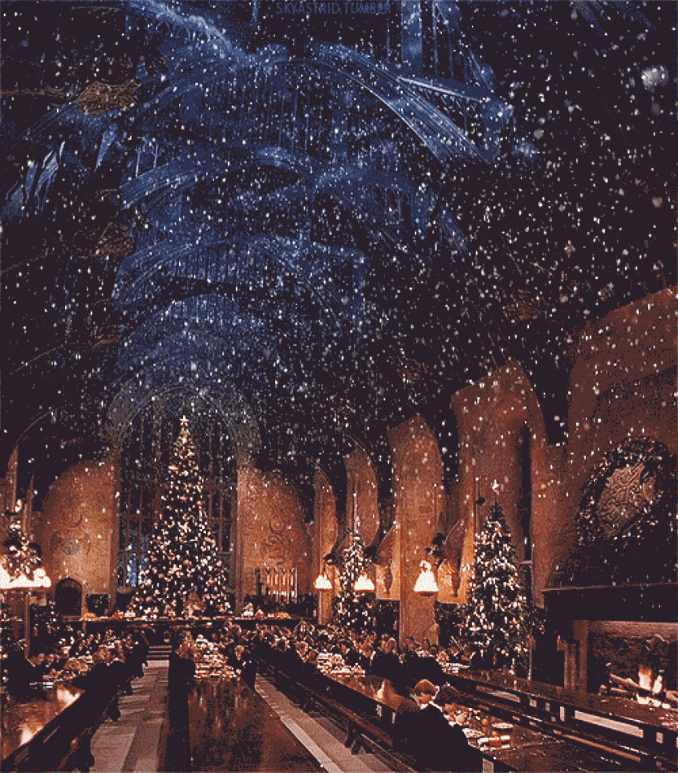
№11. When do British people celebrate Christmas?
START TIMER
TIME’S UP!

Slide 14

№12. Who is the writer of “Mary Poppins”?
START TIMER
TIME’S UP!

Slide 15
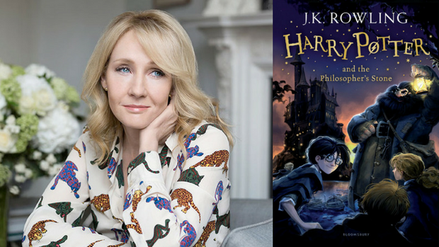
№13. Who is the author of books about Harry Potter?
START TIMER
TIME’S UP!

Slide 16
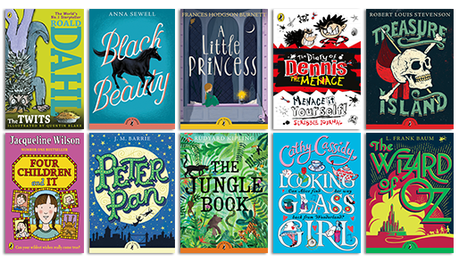
№14. What books of English writers do you know?
START TIMER
TIME’S UP!

Slide 17
Round II
Do you know Great Britain?

Slide 18
1. What river does London stand on?
A. The Severn
B. The Trent
C. The Thames
D. The Potomac

Slide 19
3. How old is London?
A. 1000
B. 1974
C. 1500
D. 2500

Slide 20
4. What is the largest park in London?
A. Green Park
B. Hyde Park
C. Richmond Park
D. Regent's Park

Slide 21
5. Who is the present monarch in Great Britain?
A. Prince Charles
B. Prince Henry
C. Queen Elizabeth I
D. Queen Elizabeth II

Slide 22
6. How many countries does the UK consist of?
A. 3
B. 5
C. 4
D. 6

Slide 23
8. Choose the famous place where every person can speak on any theme.
A. Hyde Park
B. Trafalgar Square
C. Piccadilly Circus
D. the National Gallery

Slide 24
What building is situated in the centre of Trafalgar Square
A. the National Gallery
B. Buckingham Palace
C. Trajan's Column
D. Nelson Column

Slide 25
Round III
Alphabet

Slide 26
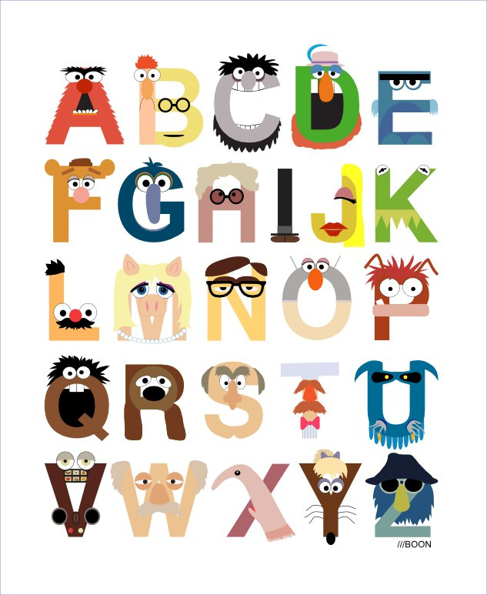
TIME LIMIT:
2 minutes
START TIMER
TIME’S UP!

Slide 27
Round IV
Rhyme-time

Slide 28
Cat
Plate
Car
Floor
Book
Lamp
House
Pen
Bag
Light
Day
Tree
flag
Door
mouse
fat
Far
Three
pay
took
camp
Men
gate
night

Slide 29
Round V
Places

Slide 30
O t e
h _ _ _ l
s _ _ _ _ e
c _ _ _ _ _ y
u_ _ _ _ _ _ _ _ y
s _ a
s _ _ _ _ l
c _ _ _ _ _ l
START TIMER
TIME’S UP!
Q u a r
TIME LIMIT:
1 minute
O u n t r
N I v e r s I t
e
C h o o
A p I t a

Slide 31
Round VI

Slide 32
START TIMER
TIME LIMIT:
2 minutes
TIME’S UP!
DEMONSTRATION

Slide 33
wnrob
yphap
tisers
rkhomewo
erfath
lowyel
waethre
palep
welvet
hantepel
brown
happy
sister
homework
father
yellow
weather
apple
twelve
elephant

Slide 34
Round VII
Riddles

Slide 35
1. It runs but has no legs.
2. It’s black when it’s clean.
3. It has teeth but it can’t bite.
4. Children don’t like to drink especially when it’s warm.
5. It is white. It is cold. We can skate on it. What is it?

Slide 36
6. What man cannot live inside the house?
7. A little old woman with twelve children. Some short, some long, some cold, some hot. What is she?
8. What goes up when the rain comes down?
9. He is not a tailor but carries needles with him.

Slide 37
Round VIII
Crossword

Slide 38
